Slide 1
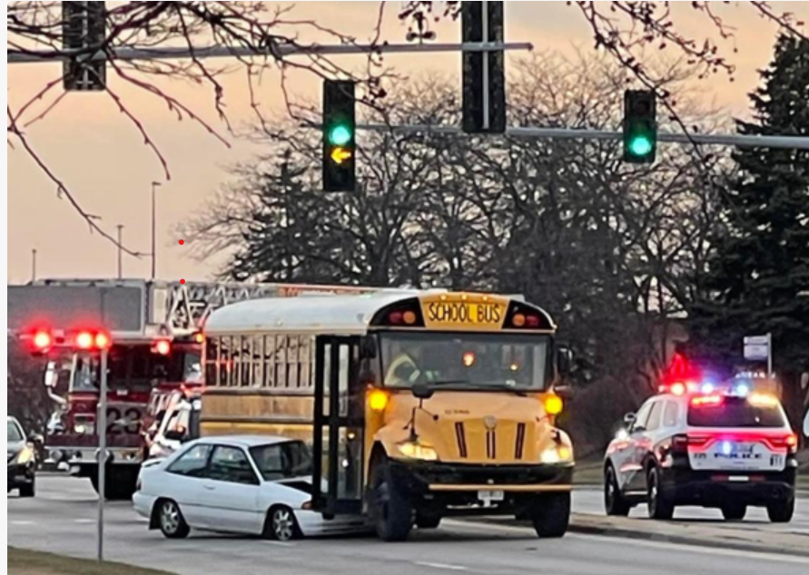
CHICAGO CAR CRASHES

Slide 2
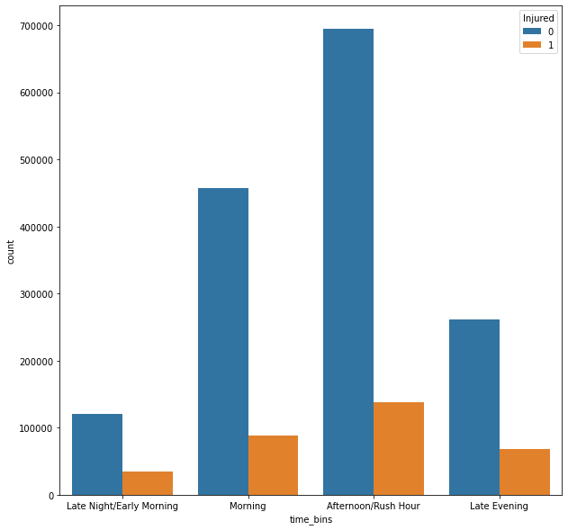
It was observed that most of the accidents occurred in the afternoon/rush hour and this contributed to the most injuries.

Slide 3
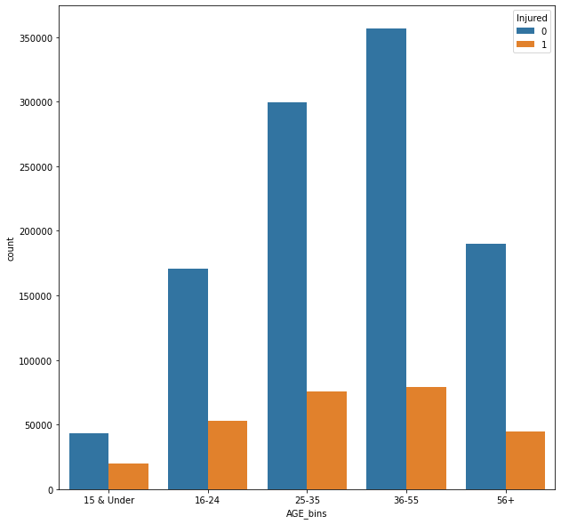
Most of the injuries were noted in people in the aged of 25 – 35 and 35-55.

